Slide 1
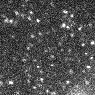
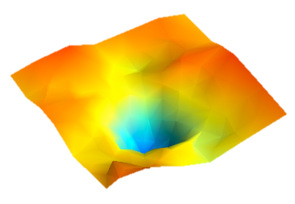
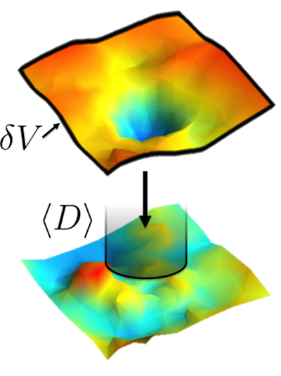
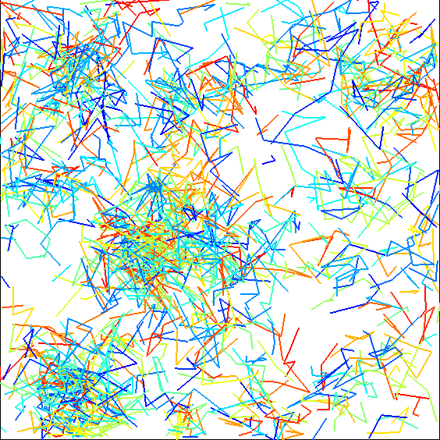
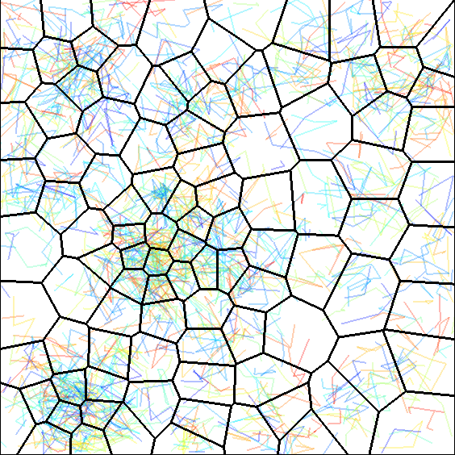
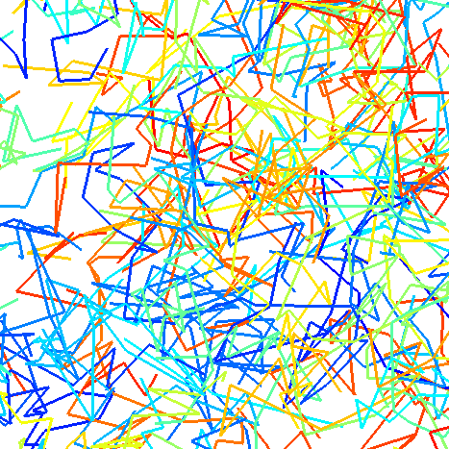
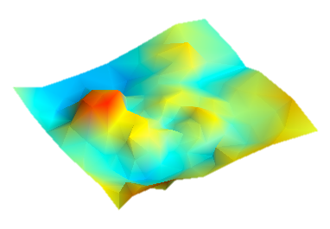
TRamWAy
A Python library for single molecule dynamics
Available at: https://github.com/DecBayComp/TRamWAy
Single molecule imaging
Localization
and tracking
Tessellation
and partition
Parameter maps
Feature extraction
Potential energy
Diffusivity
François Laurent
francois.laurent@pasteur.fr

Slide 2
TRamWAy
Displacement = directional bias + random motion

Slide 3
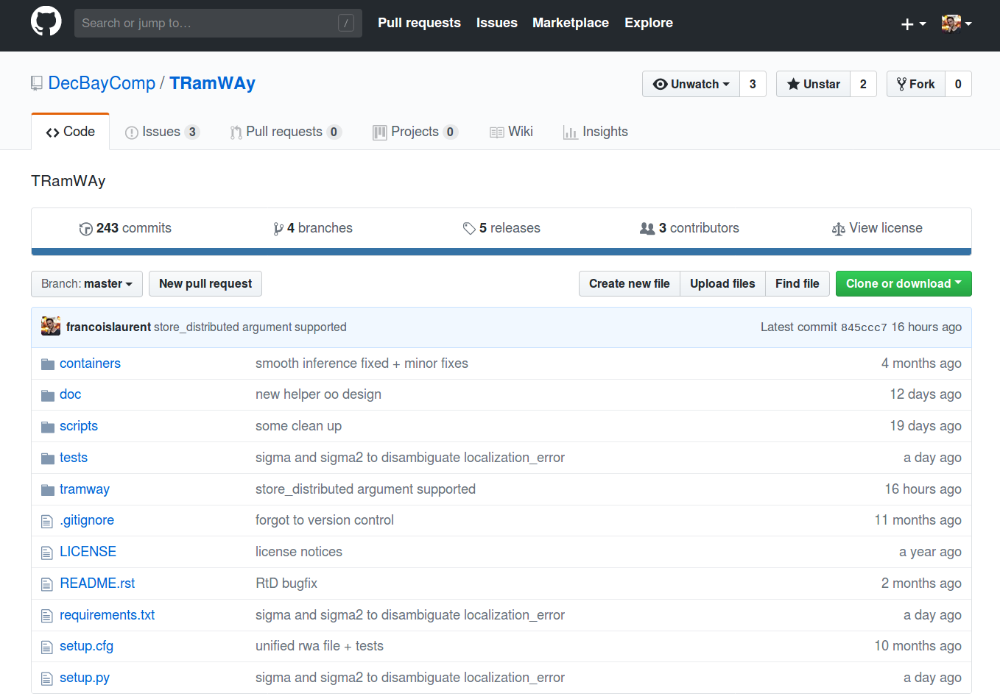
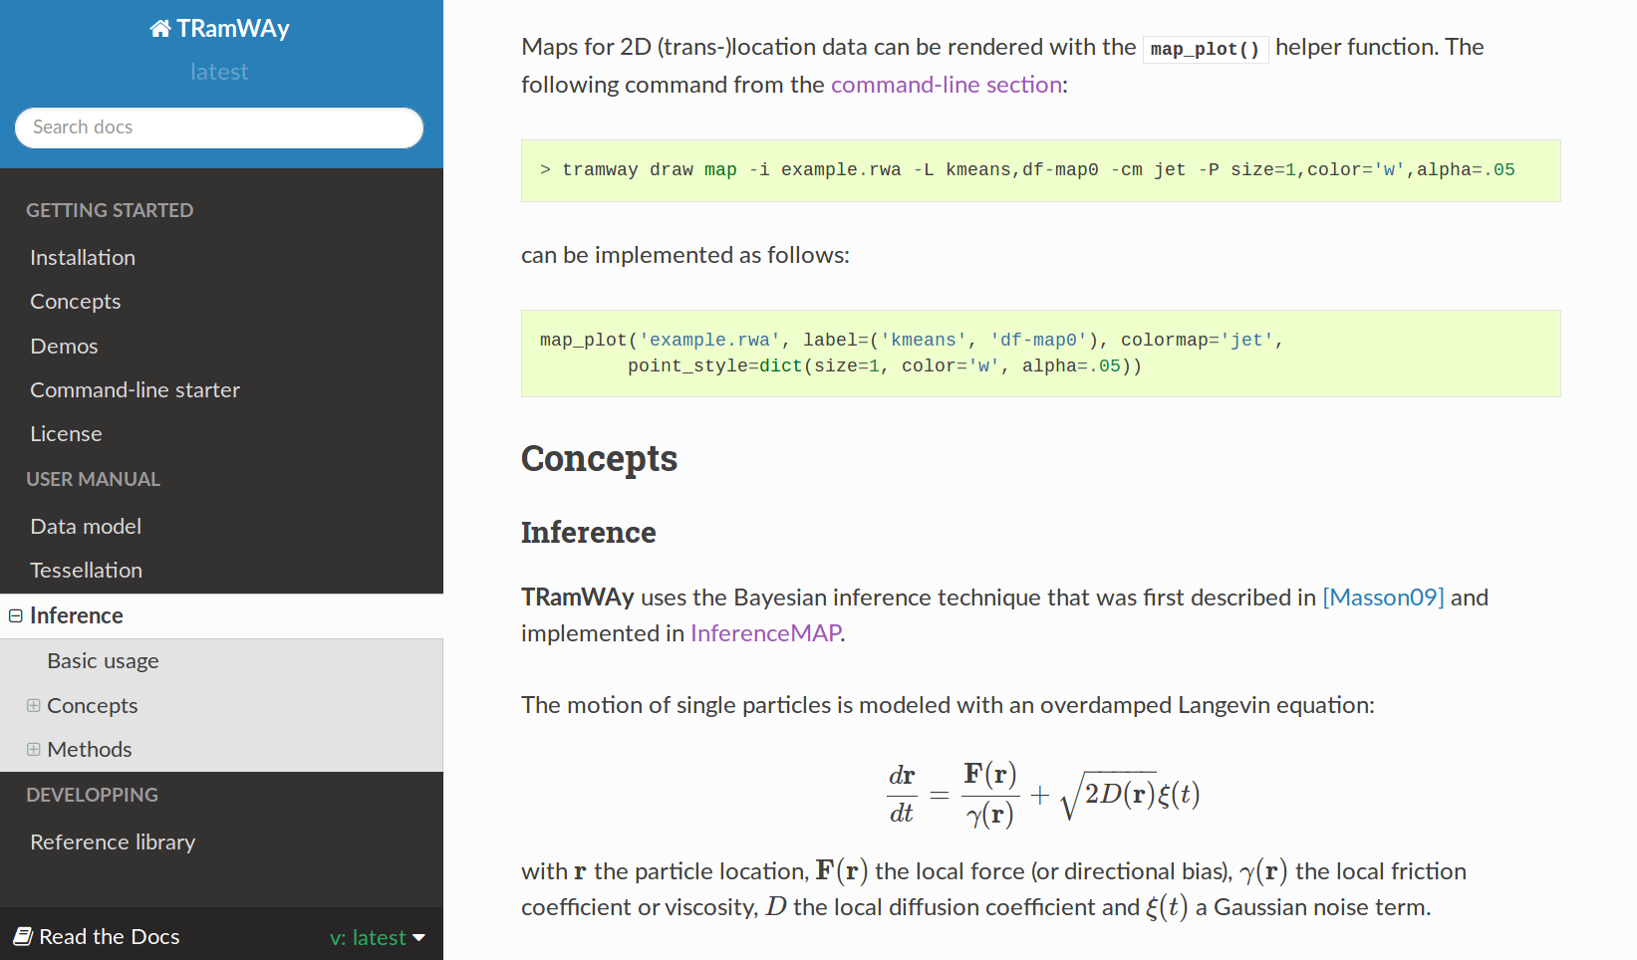
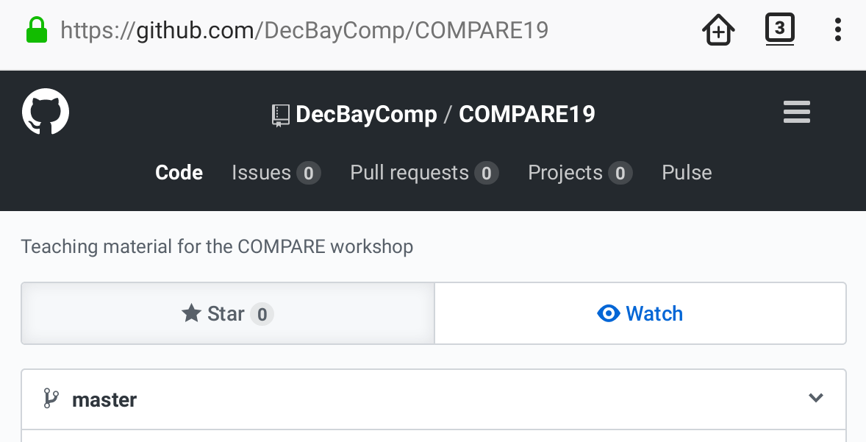
Workshop material
git clone https://github.com/DecBayComp/COMPARE19

Slide 4
TRamWAy
A Python library for single molecule dynamics
No GUI
Available at: https://github.com/DecBayComp/TRamWAy
Single molecule imaging
Localization
and tracking
Tessellation
and partition
Parameter maps
Feature extraction
Potential energy
u-track Jaqaman et al., Nature Methods 5:695-702 (2008)
MTT Sergé el al., Nature Methods 5:687-94 (2008)
Various Chenouard et al., Nature Methods 11:281-9 (2014)
Diffusivity

Slide 5
Trajectories
1 19.8384 16.1616 0.05
1 19.68 16.0112 0.1
1 19.6864 16.016 0.15
1 19.6432 16.2176 0.2
1 19.7984 15.9502 0.25
1 19.7408 15.9133 0.3
1 19.8032 15.9203 0.35
1 19.7168 16.1184 0.4
1 19.9552 15.8808 0.45
2 22.0592 11.7726 0.05
2 22.1024 11.9558 0.1
2 22.2832 11.7954 0.15
2 22.1488 11.8546 0.2
2 22.2448 11.7696 0.25
2 22.4016 11.6939 0.3
2 22.472 11.6504 0.35
2 22.2928 11.8488 0.4
2 22.0512 11.9766 0.45
4 26.7776 24.2416 0.05
4 26.9968 24.2192 0.1
4 26.9408 24.2112 0.15
4 26.9168 24.1984 0.2
4 27.1136 24.2048 0.25
4 27.2496 24.2256 0.3
4 27.2448 24.3024 0.35
4 27.008 24.4672 0.4
4 26.976 24.232 0.45
4 27.0544 24.2032 0.5
4 27.2512 24.3872 0.55
4 27.368 24.3776 0.6
4 27.4368 24.3952 0.65
4 27.344 24.3216 0.7
4 27.2128 24.3872 0.75
4 27.168 24.5952 0.8
4 27.2144 24.5232 0.85
4 27.1088 24.5472 0.9
4 26.8688 24.4336 0.95
4 26.8096 24.3248 1
4 27.144 24.5008 1.05
4 26.8336 24.2592 1.1
5 28.2864 17.2512 0.05
5 28.2048 17.384 0.1
5 27.9504 17.352 0.15
5 27.9728 17.2304 0.2
5 28.1776 17.1936 0.25
5 28.152 17.4432 0.3
5 28.1472 17.6448 0.35
5 28.1264 17.6224 0.4
5 28.0336 17.5008 0.45
trajectory index
Text file
space coordinates
n
x
y
t
time

Slide 6
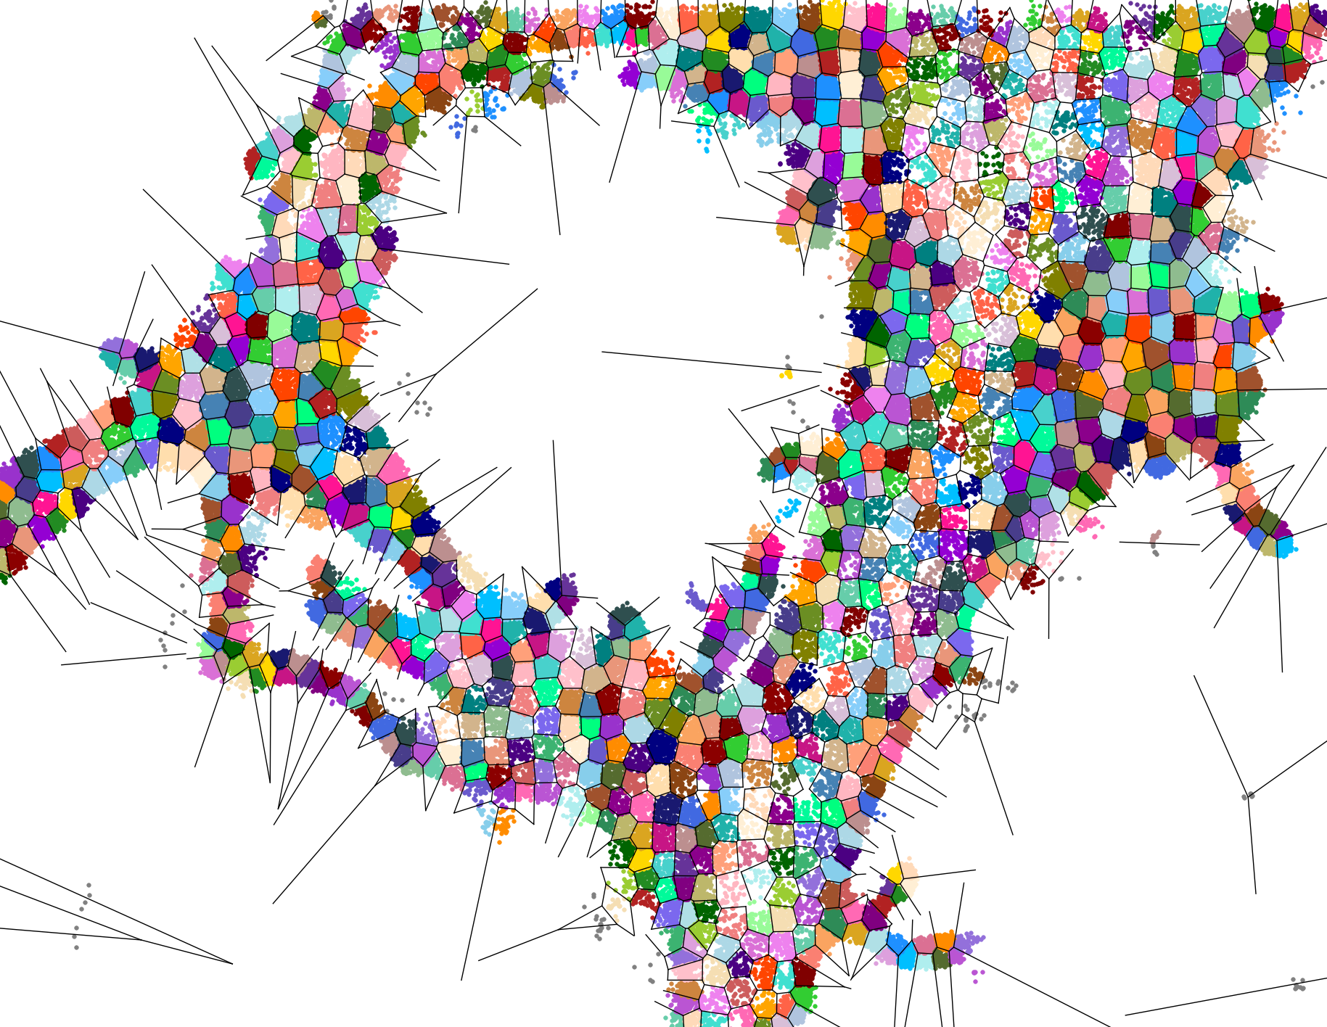
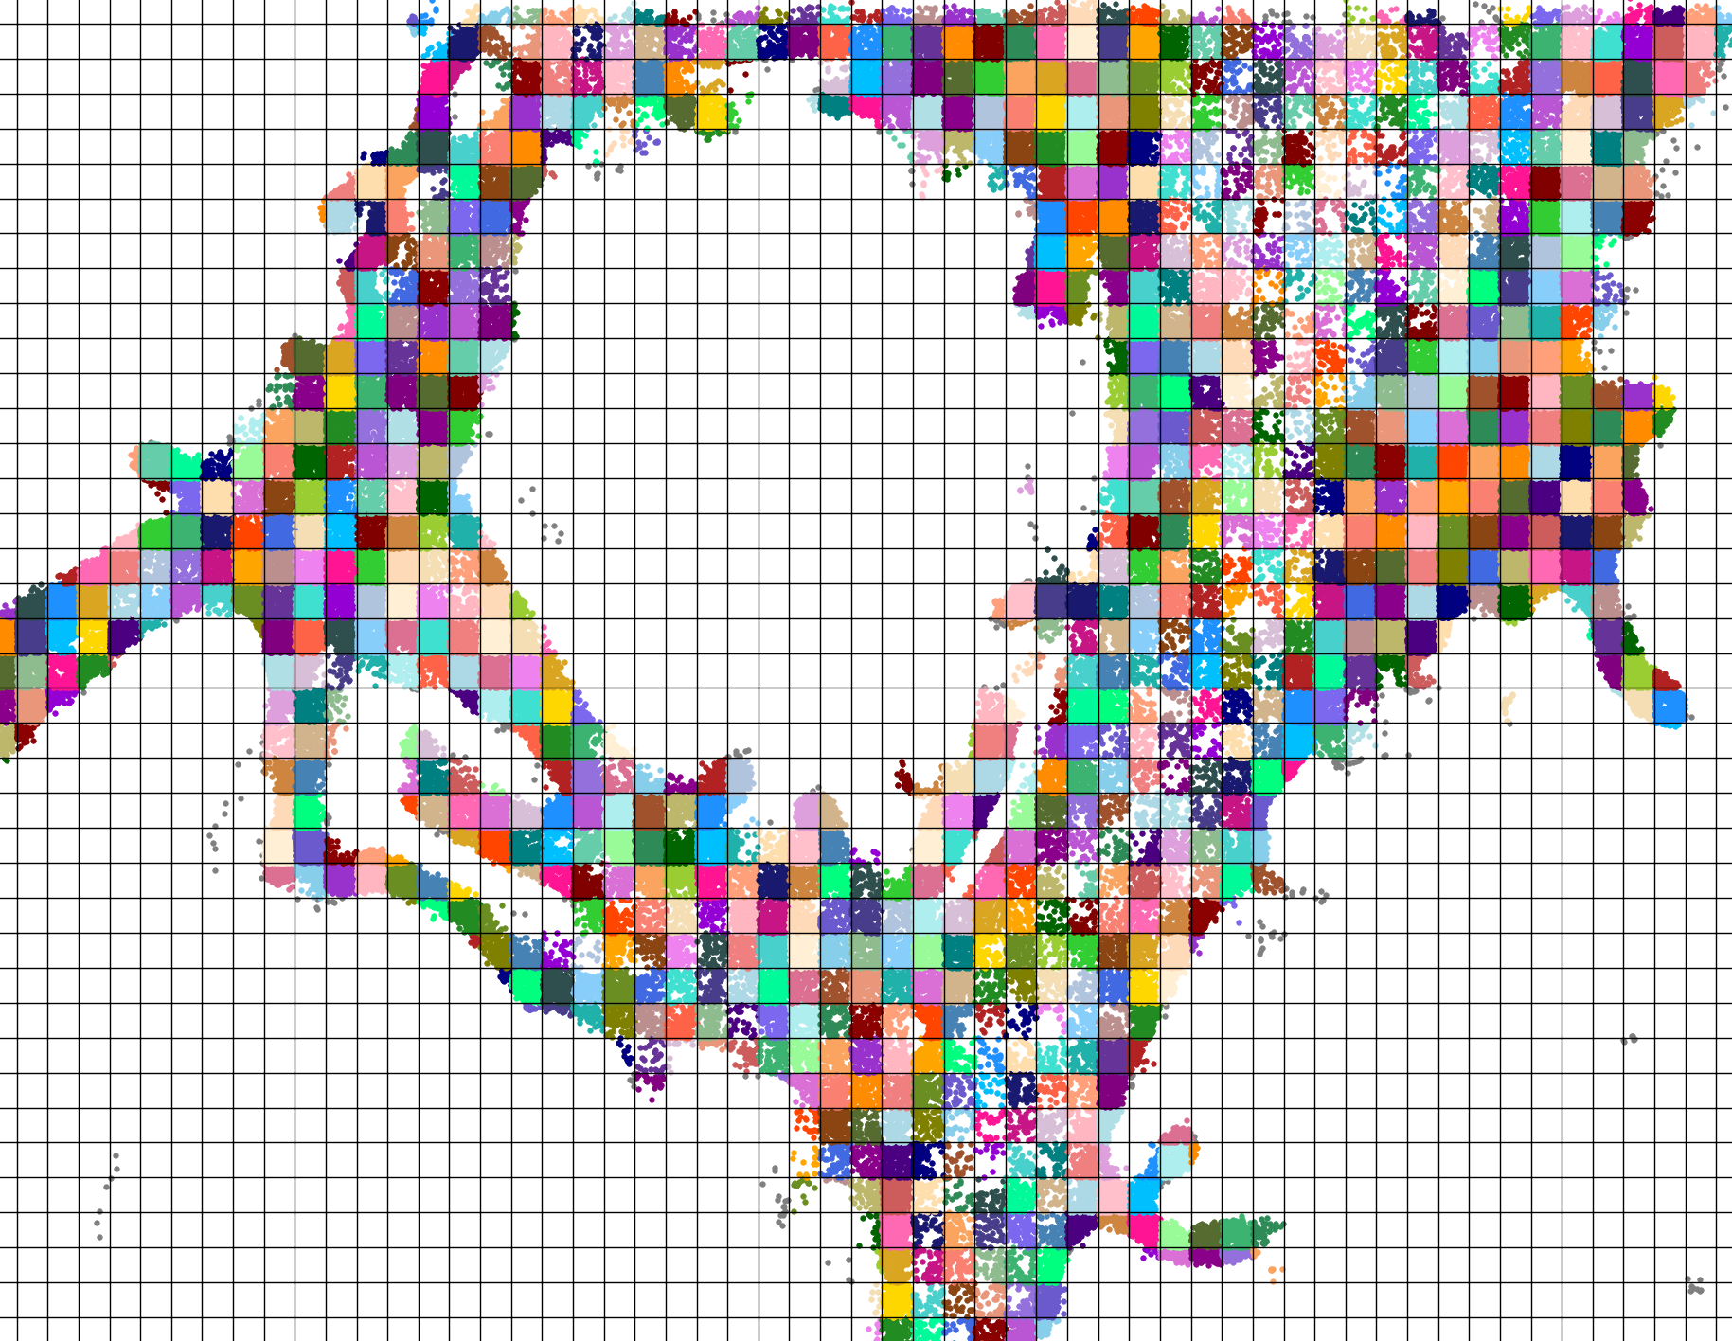
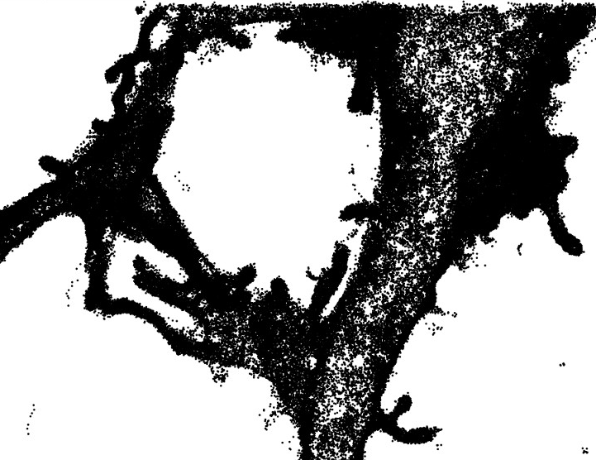
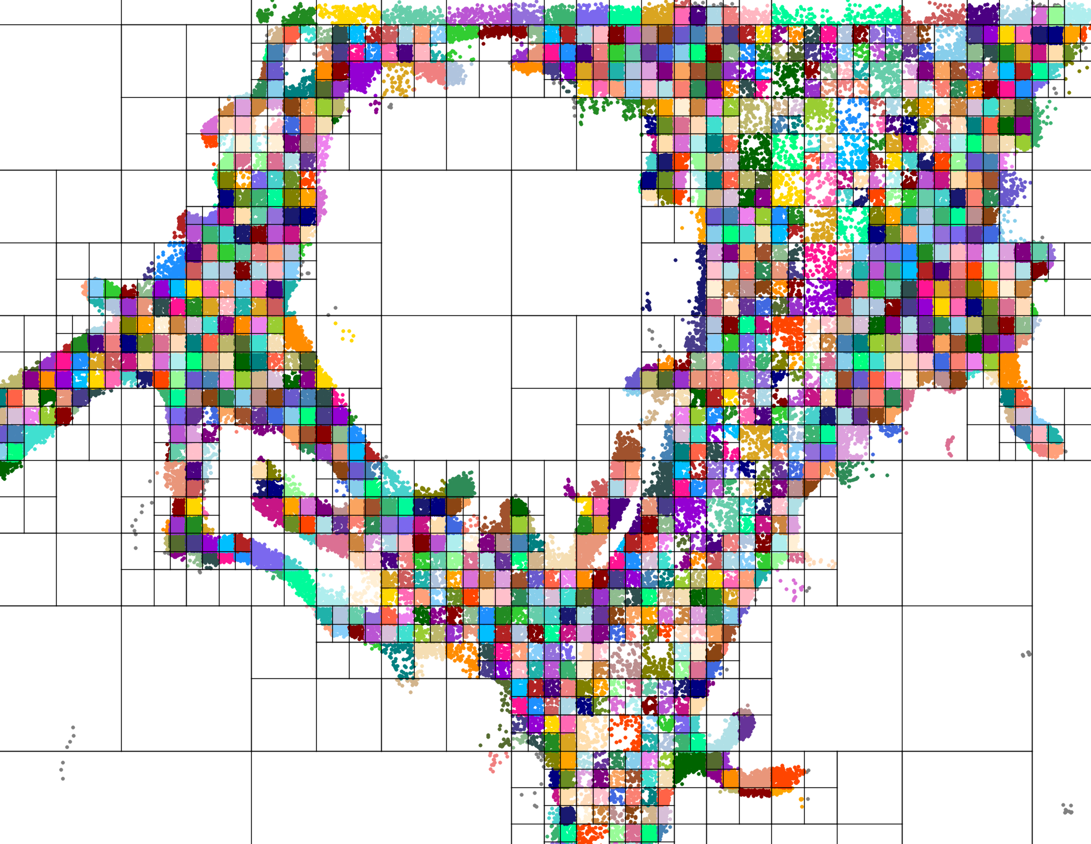
Tessellation
Spatial binning
Time segmentation
k-means
regular grid
$> tramway tessellate hexagon -i my_file.txt ...
from tramway.helper import *
tessellate('my_file.txt', 'hexagon', ...)
k-d tree

Slide 7

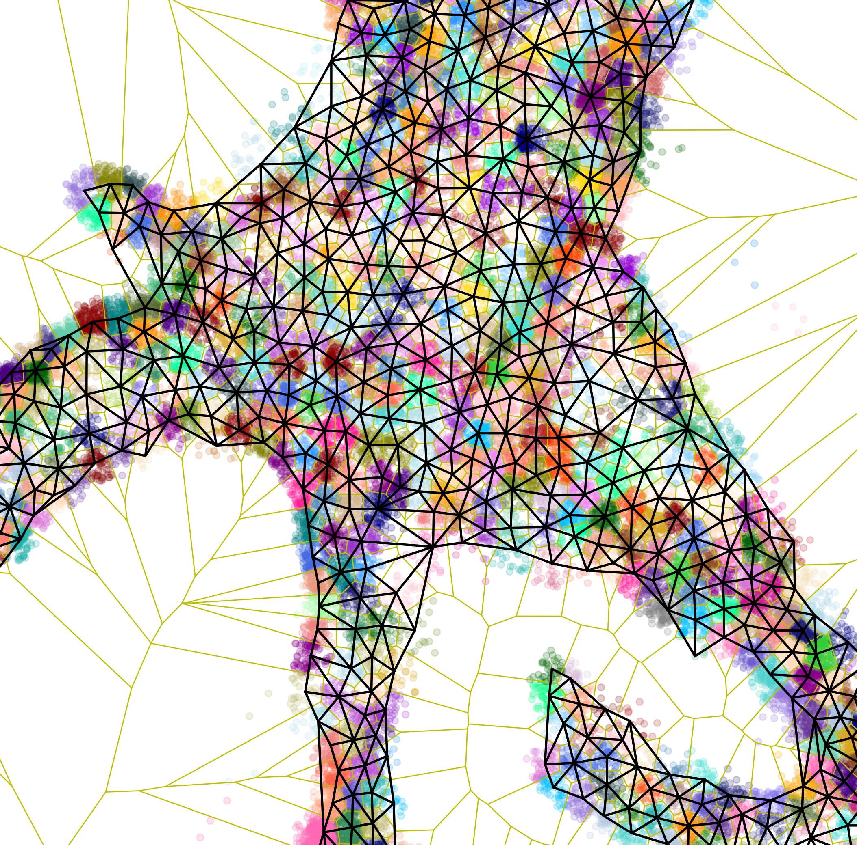
Spatial tessellation
Growing When Required
Glycine receptor locations
Spatial mesh (Delaunay and Voronoi graphs)

Slide 8
Inference
Basic features
$> tramway infer density -i my_file.rwa ...
from tramway.helper import *
infer('my_file.rwa', 'density', ...)
Density

Slide 9
Inference
Diffusivity, force, etc
$> tramway infer DV -i my_file.rwa ...
from tramway.helper import *
infer('my_file.rwa', 'DV', ...)
Diffusivity
Force

Slide 10
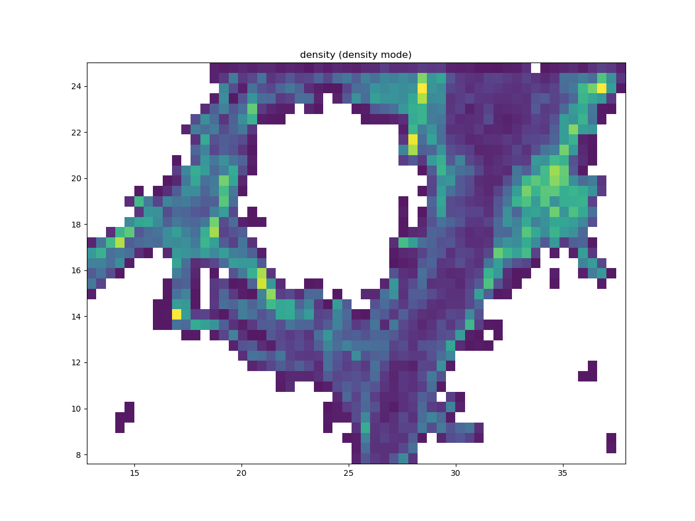
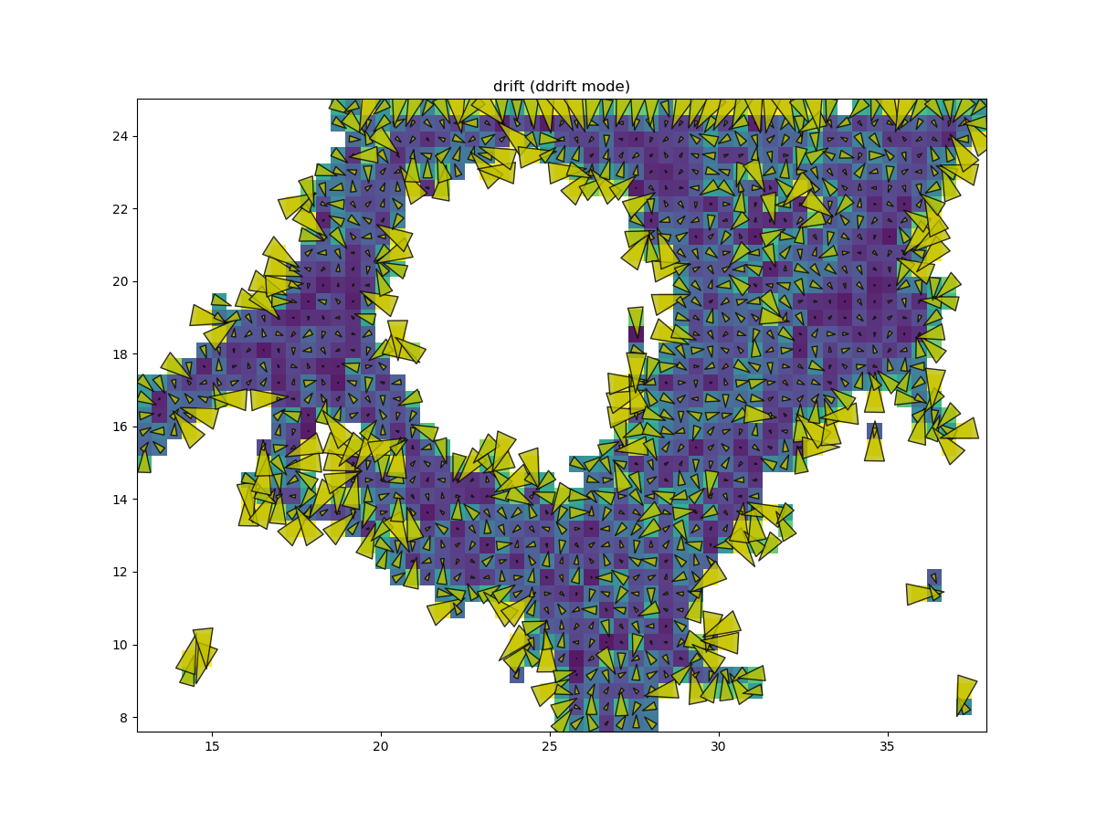
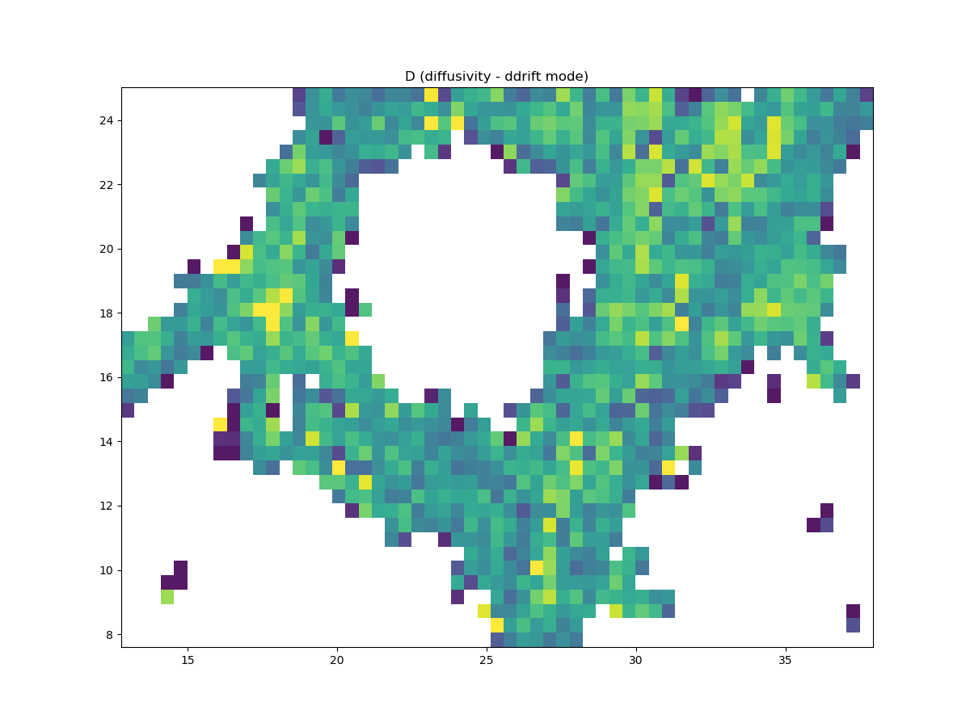
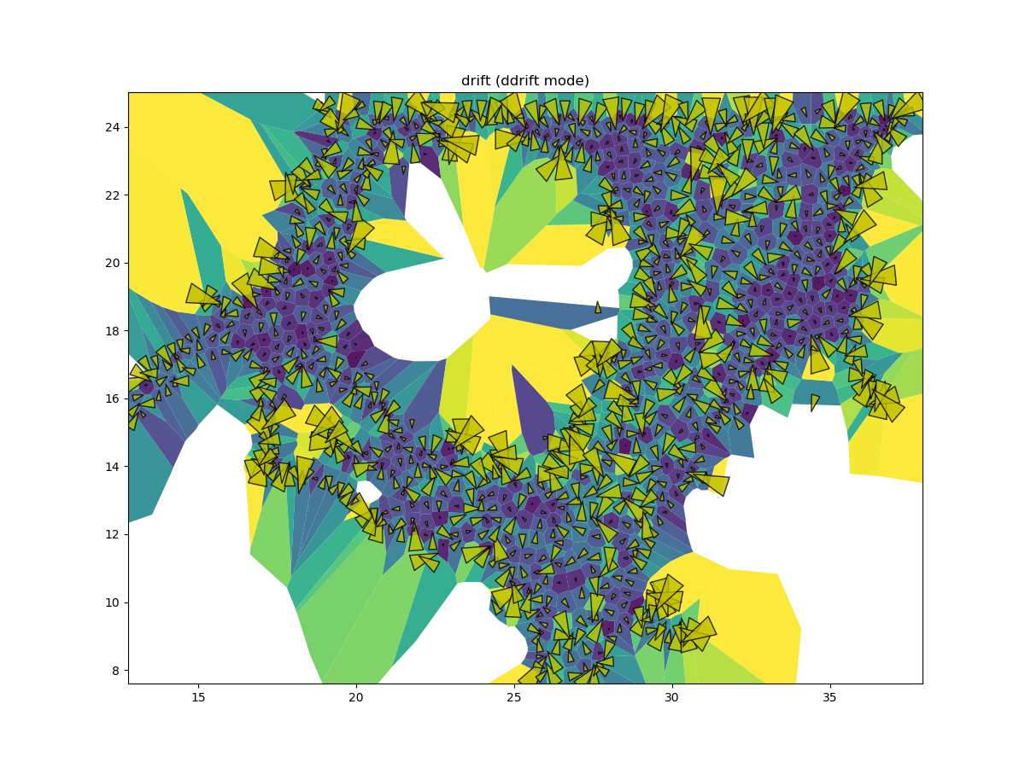
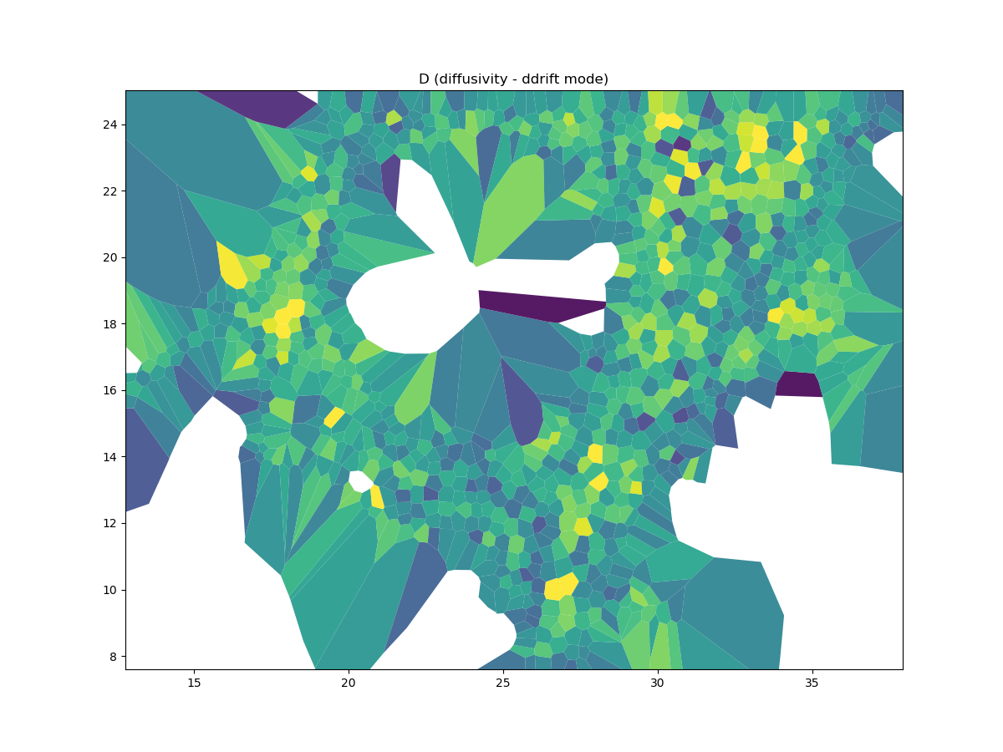
Data structure
Analysis tree
(Trans-)location data
Grid tessellation
input_label
output_label
Grid tessellation
stored in an .rwa file
Density map
Density map
k-means tessellation
DV maps
DV maps

